Slide 1
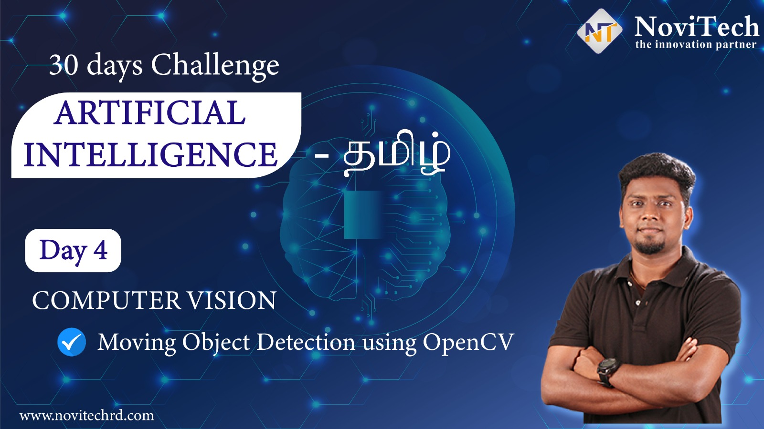

Slide 2
Announcement
Attendance link will be shared in between the session
Minimum 28 Days Attendance required to receive your FREE E-CERTIFICATE (with same mobile number & email id)

Slide 3
Prerequisites for this Course
Laptop with Good Internet
No basic knowledge is required.
Note & Pen

Slide 4
Moving Object Detection
Moving object detection is a technique used in computer vision and image processing. Multiple consecutive frames from a video are compared by various methods to determine if any moving object is detected.

Slide 5
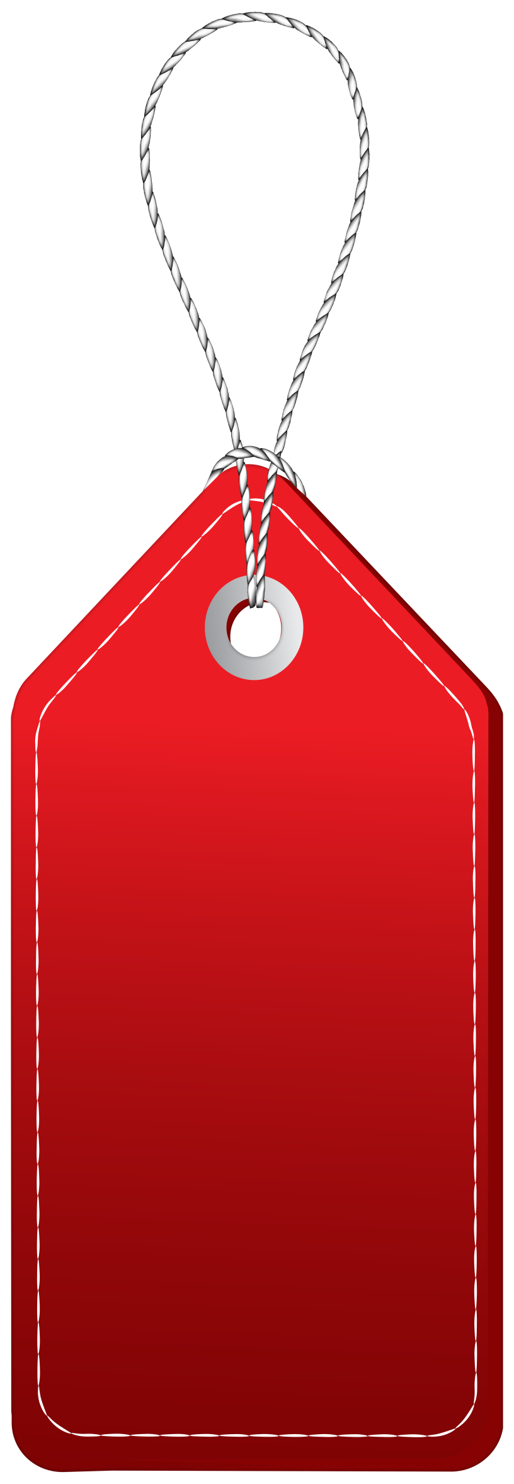

Solution - Internship
30 Day Recorded Video Lectures (₹4000)
20+ Projects (₹30,000)
Bonus Task, Assignments (₹1,500)
Technical Material(PPT, Mindmap) (₹1,000)
Rs.40,000
100 AI Interview Questions(1500)
Rs.1,999
Hand Signed Printed Certificate For Internship with your Photocopy (₹2,000)
Live Q&A Session on next 5 Saturdays
Lifetime Course Validity

Slide 6
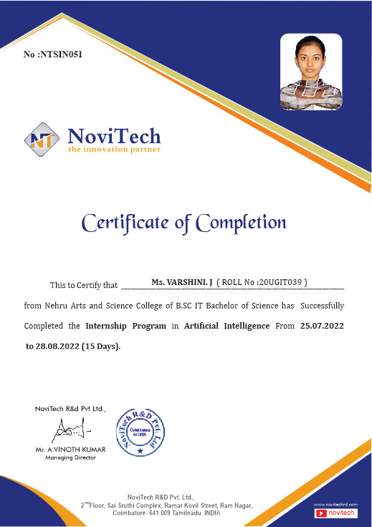

Slide 7
Ready For Hands On

Slide 8


Basic programs on Computer Vision

Slide 9
Resize an Image
import cv2
import imutils
img = cv2.imread(‘sample2.jpg’)
resizedImg = imutils.resize(img, width=500)
cv2.imwrite(‘resizedImage.jpg', resizedImg)

Slide 10
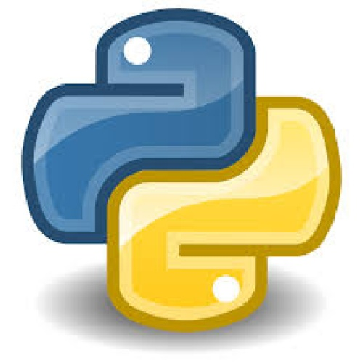

Gaussian Blur - Smoothening
import cv2
img = cv2.imread(‘sample2.jpg')
grayImg = cv2.cvtColor(img, cv2.COLOR_BGR2GRAY)
#dst = cv2.GaussianBlur(src, (kernel),borderType)
gaussianImg = cv2.GaussianBlur(grayImg, (21, 21), 0)
cv2.imwrite(“GaussianBlur.jpg”, gaussianImg)

Slide 11
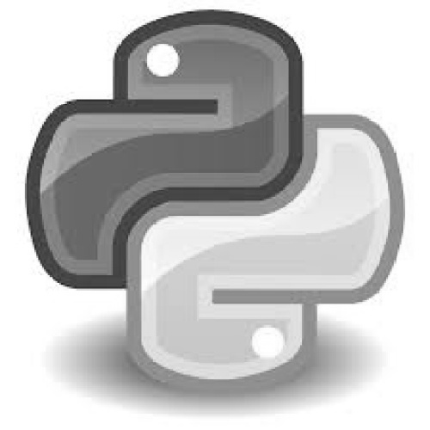
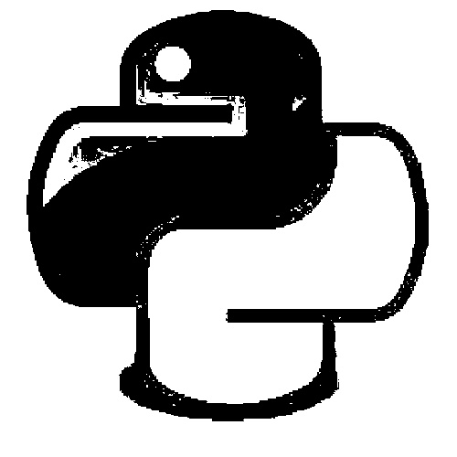
Image Properties
#dst = cv2.threshold(src, threshold, maxValueForThreshold,binary,type)[1]
import cv2
img=cv2.imread("sample.jpg")
grayImg = cv2.cvtColor(img,cv2.COLOR_BGR2GRAY)
gaussBlur = cv2.GaussianBlur(grayImg,(21,21),0)
thresholdImg = cv2.threshold(grayImg,150,255,cv2.THRESH_BINARY)[1]
cv2.imwrite("threshold.jpg",thresholdImg)

Slide 12
Drawing Rectangle
#cv2.rectangle(src,startpoint,endpoint,color,thickness)
cv2.rectangle(img, (x, y), (x + w, y + h), (0, 255, 0), 2)
Putting Text in Image
#cv2.putText(src, text, position,font,fontSize,color,thickness)
cv2.putText(img, text, (10, 20), cv2.FONT_HERSHEY_SIMPLEX, 0.5, (0, 0, 255), 2)

Slide 13
findContours
#dst =cv2.findContours(srcImageCopy, contourRetrievalMode,
contourApproximationMethod)
cnts = cv2.findContours(threshImg.copy(), cv2.RETR_EXTERNAL,
cv2.CHAIN_APPROX_SIMPLE)

Slide 14
Reading frame from camera – video streaming
import cv2
vs = cv2.VideoCapture(0)
while True:
_,img = vs.read()
cv2.imshow("VideoStream", img)
key = cv2.waitKey(1) & 0xFF
if key == ord("q"):
break
vs.release()
cv2.destroyAllWindows()

Slide 15
Ready For Project

Slide 16
Mindset of the Day
Dream Big, Our Past is not Equal to the present

Slide 17


Share the workshop link

Slide 18
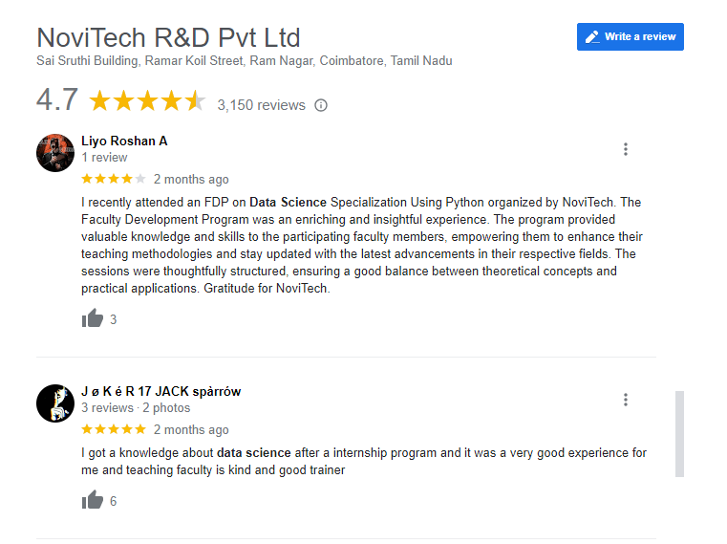

Google Review

Slide 19

Post Your Attendance

Slide 20




THANK YOU☺
NOVITECH COIMBATORE
novitechresearchanddevelopment

Slide 21
Q & A Session?

